Slide 1
From China to the Rhine-Alpine Corridor Future scenario of increasing logistics flows via the New Silk Road and implications for RALP Corridor planning
2 December 2022
Ivo Hindriks, Arnaud Burgess, Menno Menist (PANTEIA)
This project has received funding from the European Union’s Horizon 2020 research and innovation programme under the Grant Agreement No. 860274

Slide 2
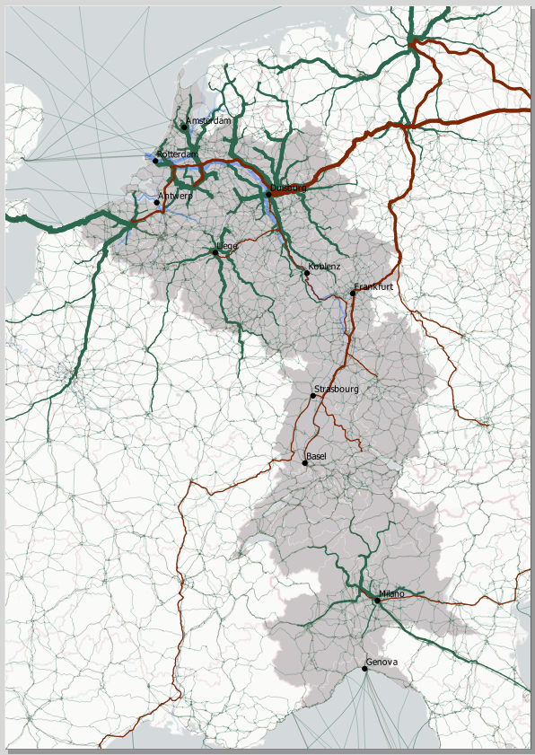
Content
Background: Eurasian Rail Freight and the RALP region
Impact on RALP: modelling results
Regional impact
Infrastructure impact
Environmental impact
Conclusion
Q&A

Slide 3
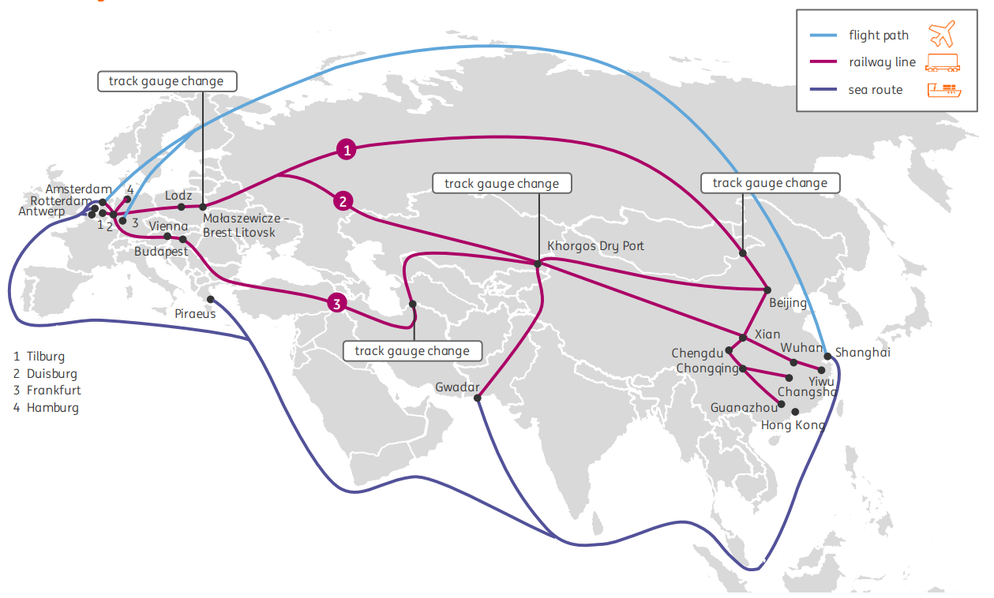
Background – Eurasian rail freight
Eurasian rail freight (“New Silk Road”), while still in its infancy, it is developing rapidly
EU-CN travel speed
Rail: 15 – 25 days
Sea: 35 – 55 days
Source: ING (2019) New Silk Road – The Golden Middle Way
Notes:
Eurasian rail freight is faster than maritime transport and cheaper than air freight, opening up new opportunities for shippers to transport cargo between Europe and China.

Slide 4
Background - Eurasian rail freight
Volumes have increased significantly since the first trains started running in 2011
What does this development have to offer for the RALP corridor?
Volume of transported containers via Eurasian Rail
In TEU, westbound and eastbound
Source: Eurasian Rail Alliance Index

Slide 5
Background - Hinterland patterns
Where in Europe do containers using Eurasian rail arrive?
In 2019, around 40% (87.000 TEU) of all imported containers from China by rail enters Europe via terminals located in the RALP Corridor, namely
Duisburg
Tilburg
Ghent
Liege
From these terminals, the containers are distributed across the European Hinterland
Transshipment per rail terminal in TEU
Terminals inside the RALP region Terminals outside the RALP region
Source: Eurasian Rail Alliance Index

Slide 6
Background – the war in Ukraine
Volume of transported containers by Eurasian Rail in 2022
The impact of the Ukraine war on Eurasian rail freight is limited, mainly because rail transit is excluded from EU sanctions.
While initial volumes declined by -40%, volumes quickly rose to normal levels.
The 'Ukraine Route' is no longer used for Eurasian rail freight, but its share was limited.
Transit through Ukraine accounted for 2% of the westbound container traffic volumes on the New Silk Road in 2021
Westbound, in TEU
Source: Eurasian Rail Alliance Index

Slide 7
Goal
Key question:
What are the next steps that need to be taken in order to exploit the full potential of Eurasian Rail Freight?
→ In order to faciltitate strategic corridor planning
Break-out sessions: your input regarding measures in order to facilitate the future development of Eurasian rail

Slide 8
The PLANET project
PLANET: Progress towards Federated Logistics through the Integration of TEN-T into a Global Trade Network
A Horizon 2020 project running from June 2020 – June 2023
PLANET addresses the challenges of assessing the impact of emerging global trade corridors on the TEN-T and ensuring effective integration of the European to the Global Network by focusing on two key R&D pillars:
A Geo-economics approach, modelling the dynamics of new trade routes and their impacts on logistics infrastructure & operations
An EU-Global network enablement through disruptive concepts and technologies (IoT, Blockchain and Physical internet, 5G ,3D printing, autonomous vehicles/automation, hyperloop)

Slide 9
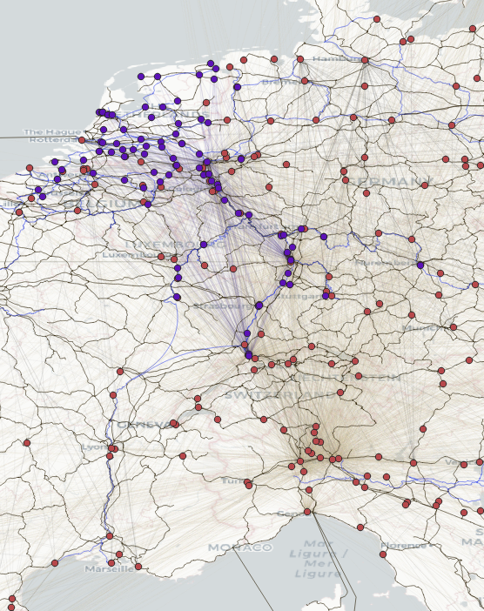
Modelling approach
Modelling based on existing Panteia models: NEAC10 and Terminal Model
Models traffic flows as multimodal chains describing the transport of a commodity from its region of production, via transhipment locations to the region of consumption
Takes into account transport costs, value of time and, shippers preference for maritime ports
The model has previously been used to estimate the modal shift potential in the EGTC region.

Slide 10
Modelling approach - Scenario’s
# | Scenario | Description
1 | 2019 | Baseline scenario (pre-covid and pre-war)
2 | 2030 | Future scenario Increased trade between EU & CN Higher share of high value good Higher density of intercontinental rail services Reduced cross-border time No Chinese subsidies
3 | 2050 | Future scenario Increased trade between EU & CN Higher share of high value good Reduced cross-border time No Chinese subsidies
4 | 2030 - port dynamics | An extention of the 2030 scenario An increase in attractiveness of the southern seaports of 5% has been assumed

Slide 11
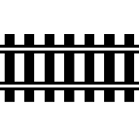
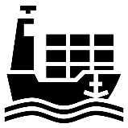
Results overview
Forecasted growth of container flows from China to Europe - rail
x million TEU
Forecasted growth of container flows from China to Europe - maritime
It is estimated that ~24% of all imported containers from China come to Europe via gateway terminals in the RALP region
x million TEU

Slide 12
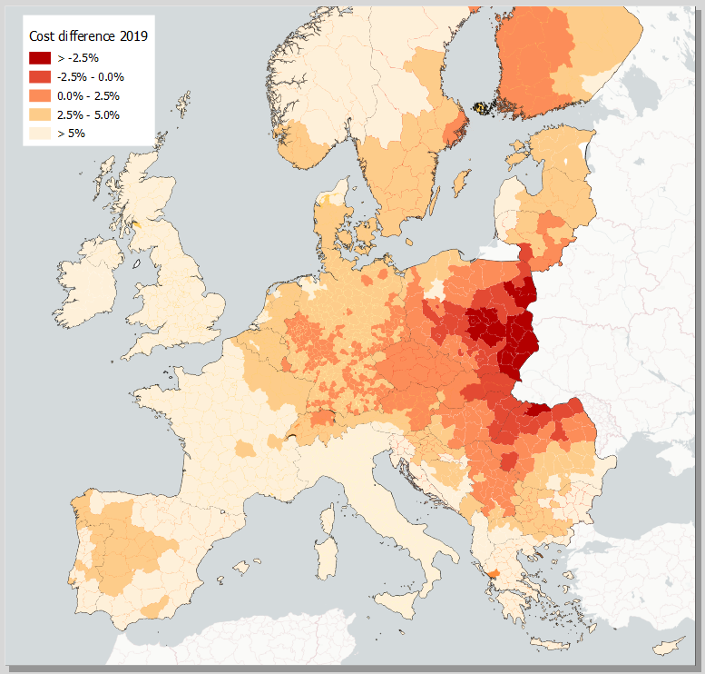
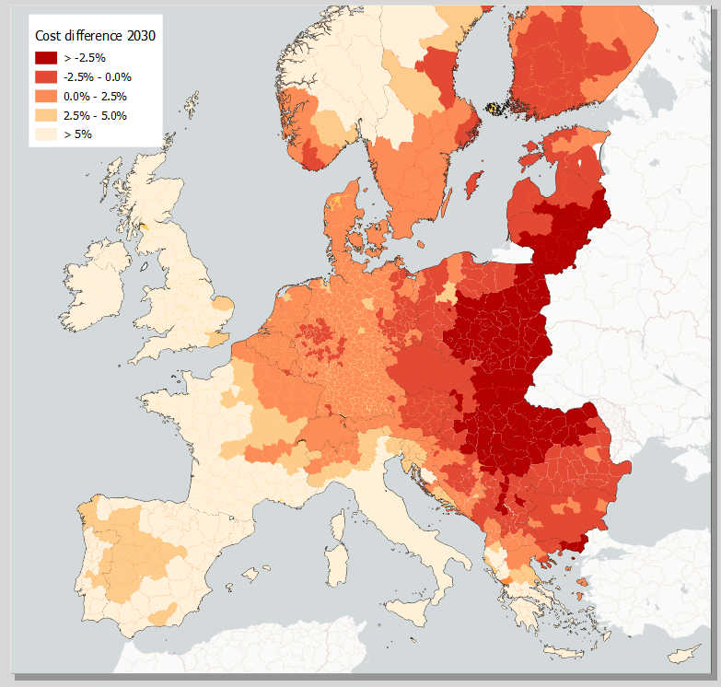
Results overview – attractiveness of rail
2019 scenario
2030 scenario
Cost difference Eurasian rail transport compared to maritime transport for high value (> 15 €/KG) goods
The geographical boundary at which Eurasian rail transport is competitive is expected to shift eastwards due to better connectivity, lower costs and new entry points
The area where investment in infra are needed becomes larger → decision-making is needed to prioritize investment needs
Cost difference Eurasian rail transport compared to maritime transport for high value (> 15 €/KG) goods
Notes:
The geographical boundary at which Eurasian rail transport is competitive is expected to shift eastwards due to better connectivity, lower costs and new entry points
The area where investment in infra are needed becomes larger → decision-making is needed to prioritize investment needs

Slide 13
Results overview – flows to the RALP region
Imported containers from China to the RALP region 2019
Imported containers from China to the RALP region 2030
Total number per intercontinental mode and shares per trade lane
Total number per intercontinental mode and shares per trade lane
Northern ports
Northern ports
Eurasian rail
- 2%
Eurasian rail
80%
78%
RALP region
3%
7%
RALP region
+4%
2019 scenario
2030 scenario
Rail: 70.000 TEU
Sea: 2.49 mln TEU
Rail: 310.000 TEU
Sea: 3.48 mln TEU
16%
15%
- 1%
Southern ports
Southern ports
Notes:
The share of northern seaports in the RALP corridor is relatively high due to good intermodal connections to the hinterland.

Slide 14
Principal entry points - PEP
Modelled containerised cargo from China to European rail principal entry points
Containers enter Europe via principal entry points - nodes with a direct connection to China
In the RALP region, modelled are three maritime PEP – Rotterdam, Antwerp and Genova – and four rail PEP – Tilburg, Liege, Duisburg and Ghent – with an additional rail PEP expected in Milan in 2030
Most increases in volumes are expected in Duisburg, but Tilburg and Ghent are also favorably located to attract additional cargo flows from China.
The expected increase in Milan is limited due to lower trade in higher-value goods in this region and the competition of sea transport
Given the large expected transport volumes, it is likely that more rail PEP will arise in Europe as they establish connections with China, such as for example Frankfurt, Mannheim or Venlo. These locations are not included in the simulations because it is very uncertain where they will arise.
For 2019 and 2030, in TEU

Slide 15
Impact on Infrastructure
Modelled network flows of Eurasian rail in 2030, baseline scenario
Rail
The impact on infrastructure in the RALP region is limited because volumes on specific sections are low
In the RALP corridor, largest expected increase in rail traffic are:
Section Hannover – Duisburg
from ~3.6 trains/day in 2019 to 14.6 trains/day in 2030
Section Duisburg – Tilburg (betuweroute)
From ~1.2 trains/day in 2019 to 6.7 trains/day in 2030
Other routes expect an increase of less than 2 trains per day
Road & terminal capacity
The biggest bottleneck for road is the capacity of the terminals to handle the containers.
An expected increase in throughput of 50,000 TEU per year (expected for Tilburg, Duisburg and Ghent) could lead to an increase of ~7 to ~15 departing trucks per hour.
The extent to which this problem is going to occur depends on where exactly container loads are going to be concentrated.

Slide 16
Environmental impact of Eurasian freight
WTW CO2 emissions
Speed and price are the most important factors in shippers' modality choice.
Sustainability plays a minor role in mode choice for now, but may be of particular interest to policymakers
Sea is almost 2.5 times more climate-friendly than rail (per tkm)
But Eurasian rail has the potential to be more climate-friendly than maritime transport because:
The rail route is almost twice as short as the sea route and
Rail terminals are ‘deeper’ in the hinterland, potentially reducing travel distances to destinations and thus saving CO2 emissions.
Per mode of transport, in g/tkm
Based on STREAM (2021)

Slide 17
Environmental impact
Difference in emissions from Eurasian Rail transport compared to maritime transport
It is found that Eurasian rail freight can be greener than maritime transport under the following conditions:
When it saves ~400 road truck kilometers in China and Europe when the North Sea ports are used.
When it saves ~530 road truck kilometers in China and Europe when the Mediterranean ports are used.
However, this is unlikely, since distances over 300 km are generally carried out intermodal.
Moreover, for rail transport, it is likely that truck is used for last mile transport, even for longer distances, since speed for cargo being transport by Eurasian rail is key.
Depending on the difference in pre- and post-haulage

Slide 18
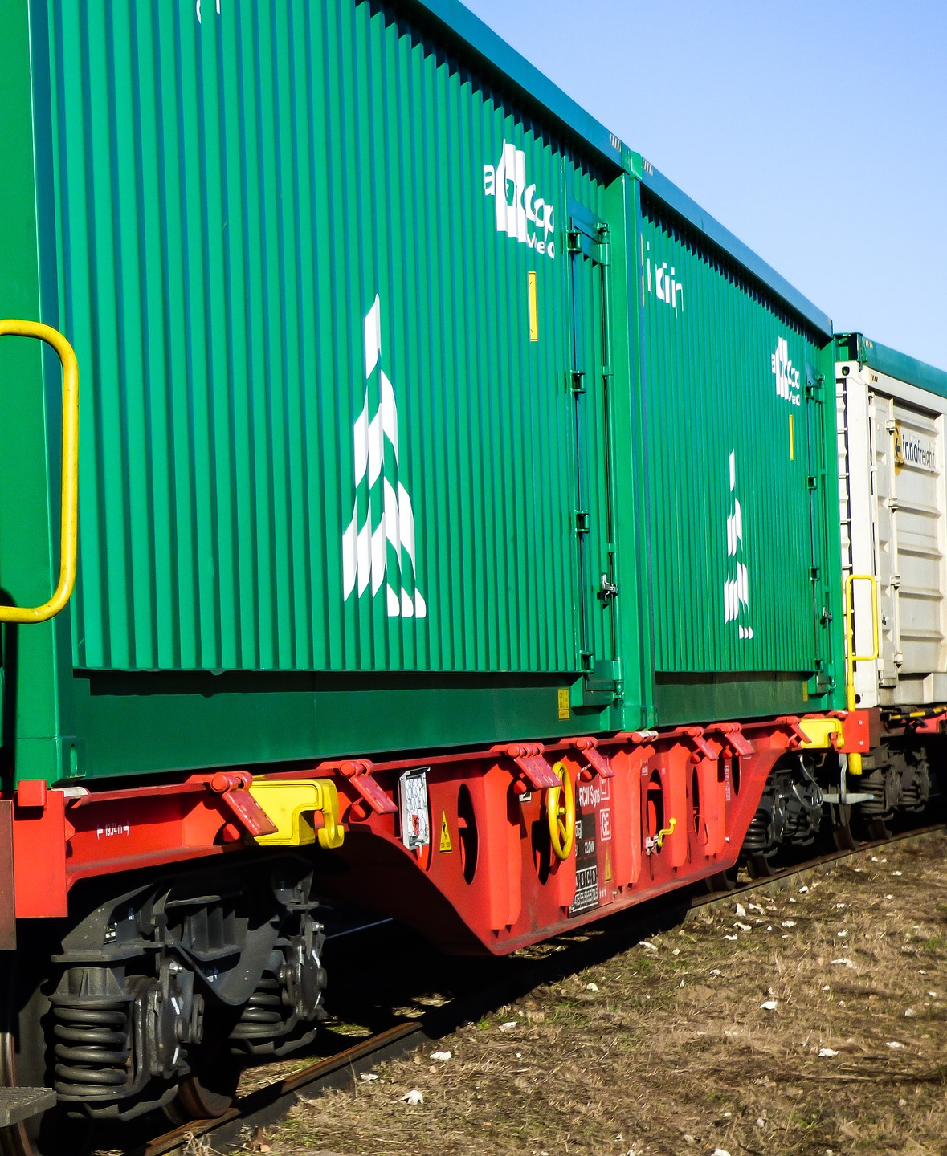
Summary
A sharp increase in volumes is expected as the route matures.
It is still uncertain however which terminals will facilitate this flow. Likely more terminals will develop rail services with China in the future (e.g. Mannheim, Venlo, Frankfurt).
Although Eurasian volumes will increase sharply, maritime transport remains highly important for the RALP region (responsible for 93% of all imported containers from China).

Slide 19
Summary
Absolute volumes of Eurasian rail transport in the RALP region are relatively low, thus also the impact on infrastructure is limited
The largest bottleneck are likely the terminals and their capacity to process the increased demand
It is unlikely that Eurasian Rail Freight will be greener than maritime transport

Slide 20
Next steps – Break-out sessions
What next steps need to be taken in order to fully exploit the potential of Eurasian Rail Freight?
Potential measures:
Investment in more PEPs along the RALP (e.g., Frankfurt, Mannheim Milan) to avoid the concentration of incoming freights at Duisburg RT (Rail terminal), Hamburg RT and Tilburg RT and share benefits among the RALP.
Infrastructure investment in rail terminal, rail tracks, and access roads: which option is most needed?
Time saving for last miles via soft measures: increase interoperability and intermodally via a new logistics system, Physical Internet (data exchange between supply chains to allocate more capacity and to promote a smart decision making).

Slide 21
Q&A
Thank you for your attention!

